Slide 1
Emotional Release
Sara Fahring

Slide 2
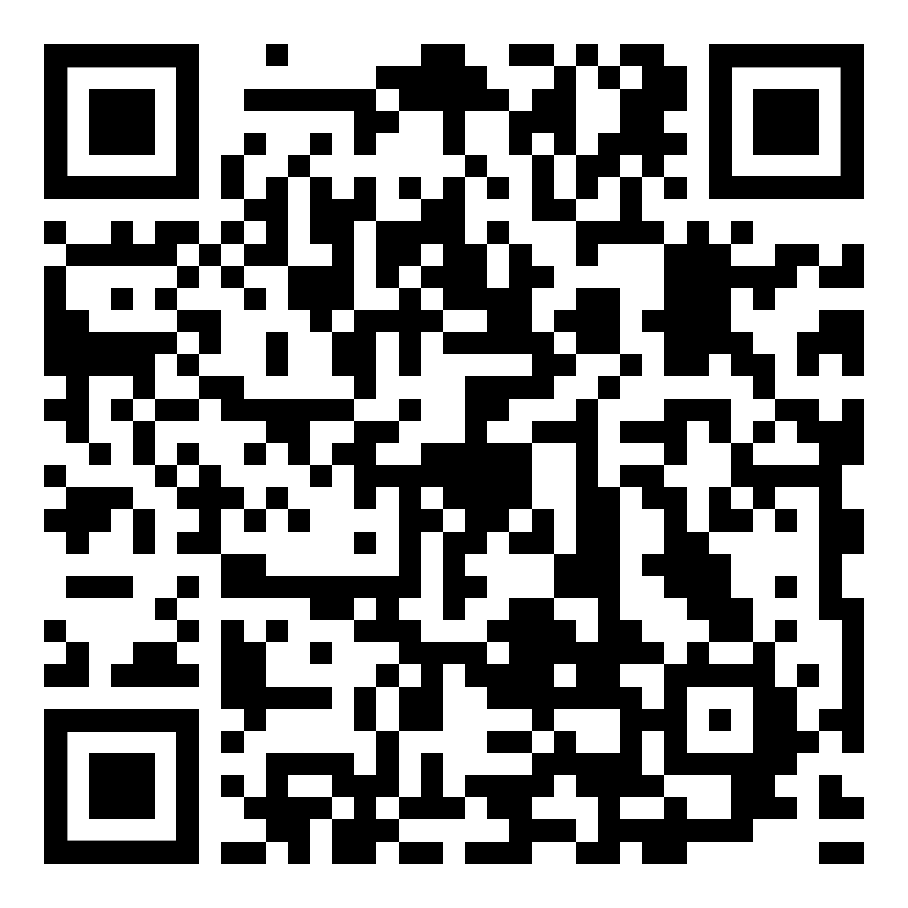
Resources
github.com/DancinFosse/Talks/blob/main/emotional_release.md
Notes:
https://github.com/DancinFosse/Talks/blob/main/emotional_release.md

Slide 3
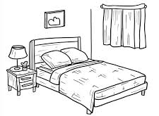
Setup
Bed
(or Yoga Mat)
2 Pillows
(with pillow cases)
Large Towel

Slide 4
Why?

Slide 5
Why?
Release emotion
Express yourself
Feels good
Healthy

Slide 6


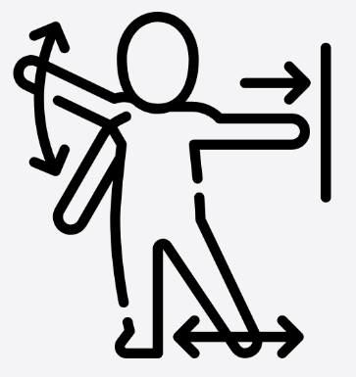
Three Elements of Somatic Release
Breath
Sound
Movement

Slide 7

Breath
1. Nose
4. Mouth - Huh
2. Belly - Out
3. Belly - In

Slide 8
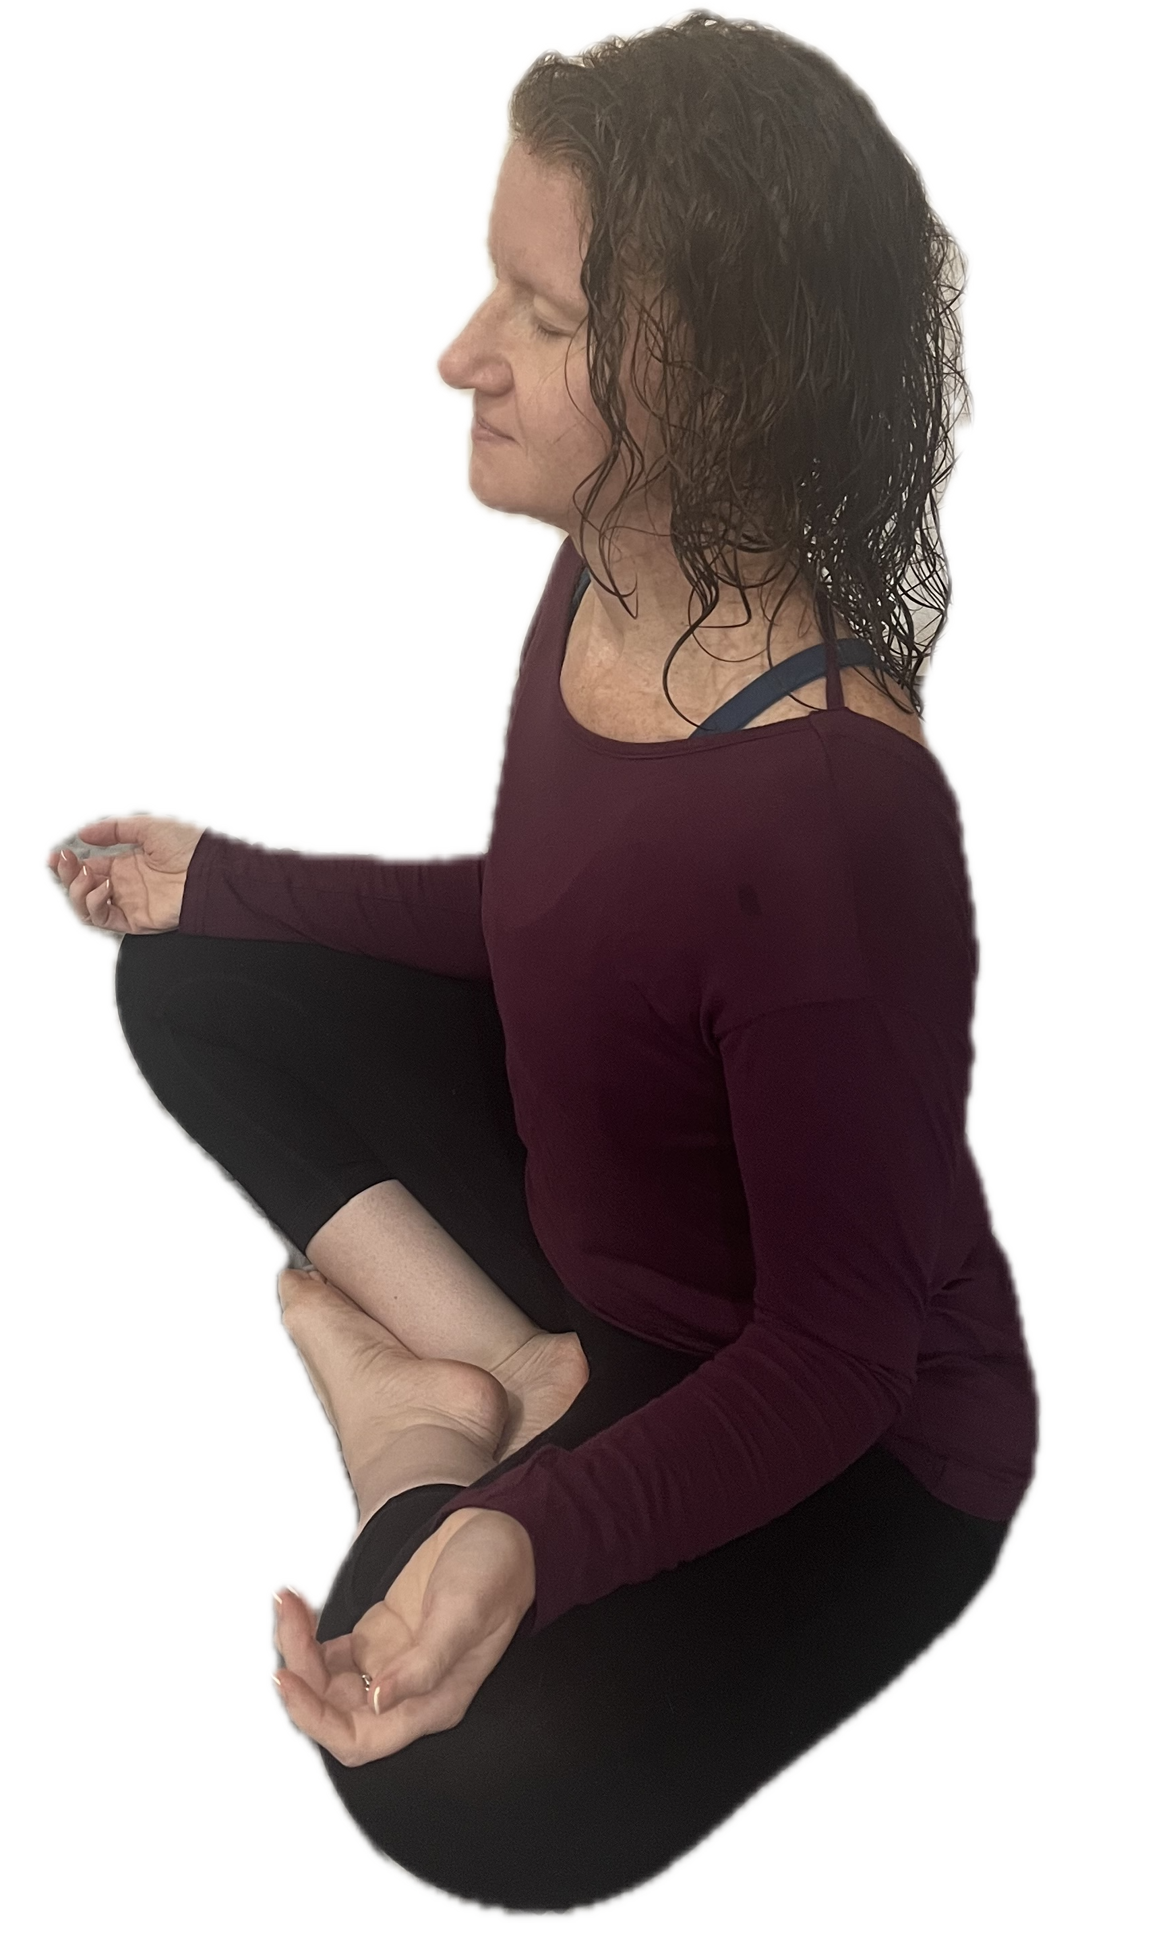
Breath
1. Nose
4. Mouth - Huh
2. Belly - Out
3. Belly - In

Slide 9
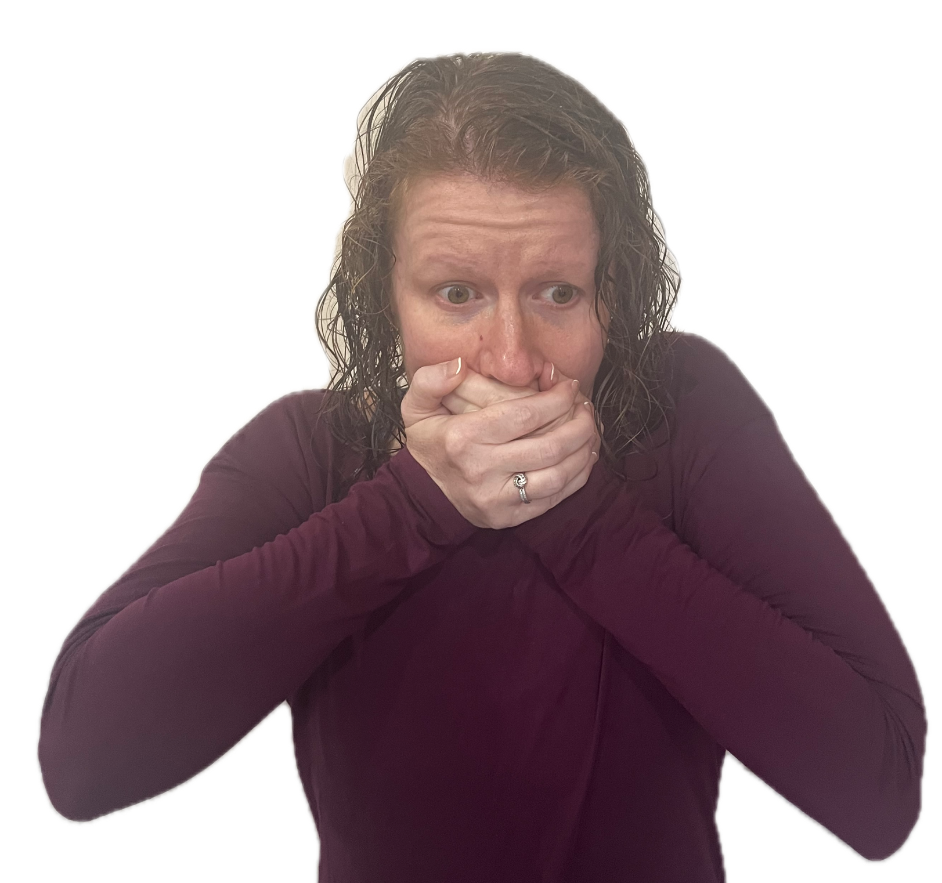
Hand Scream
Technique #1
Exhale
“Augghh”
Wiggle

Slide 10
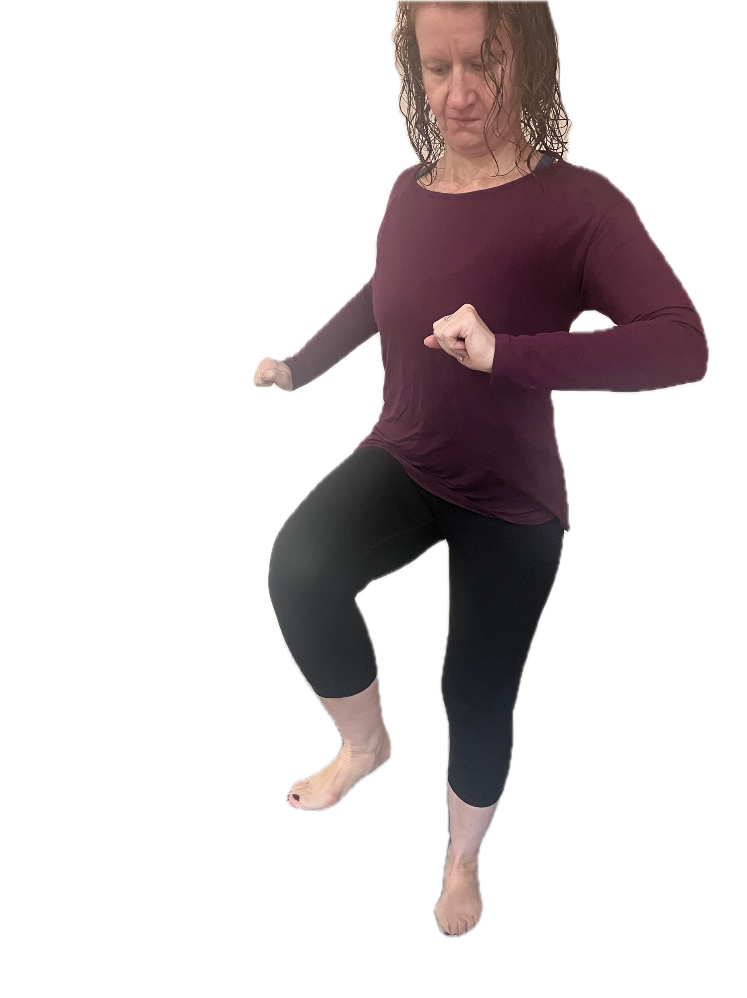
Foot Stomping
Technique #2
Exhale
“NO!”
Stomping

Slide 11
Hand Scream and Foot Stomping
Bonus Technique

Slide 12
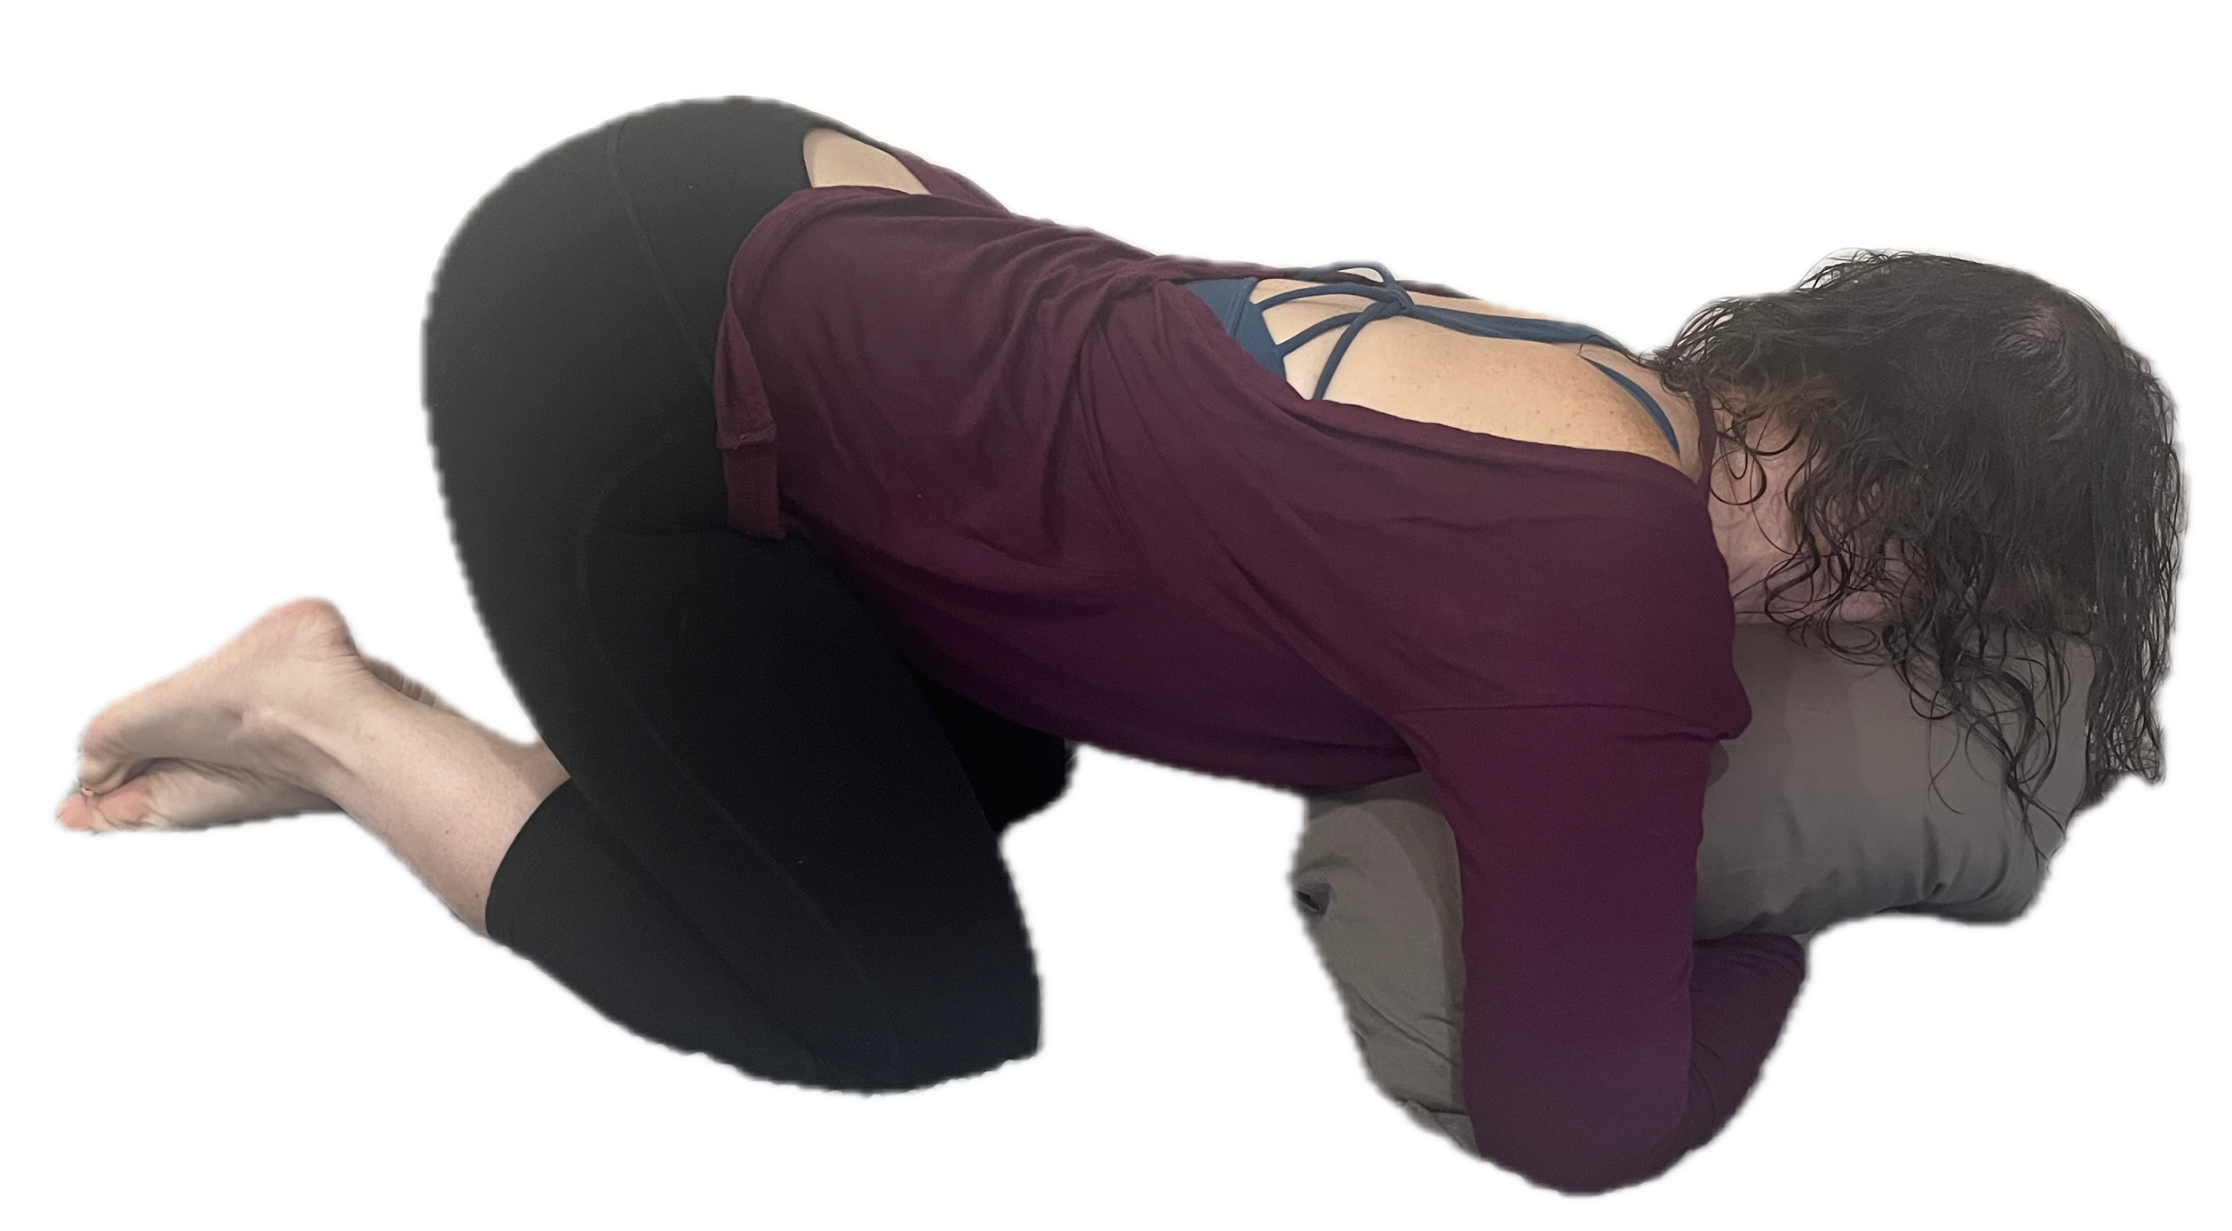
Pillow Screaming
Technique #3
Exhale
Belly scream
Exhale
Wiggling

Slide 13
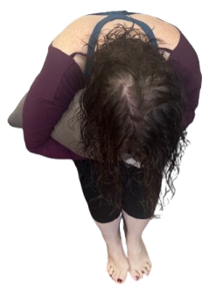
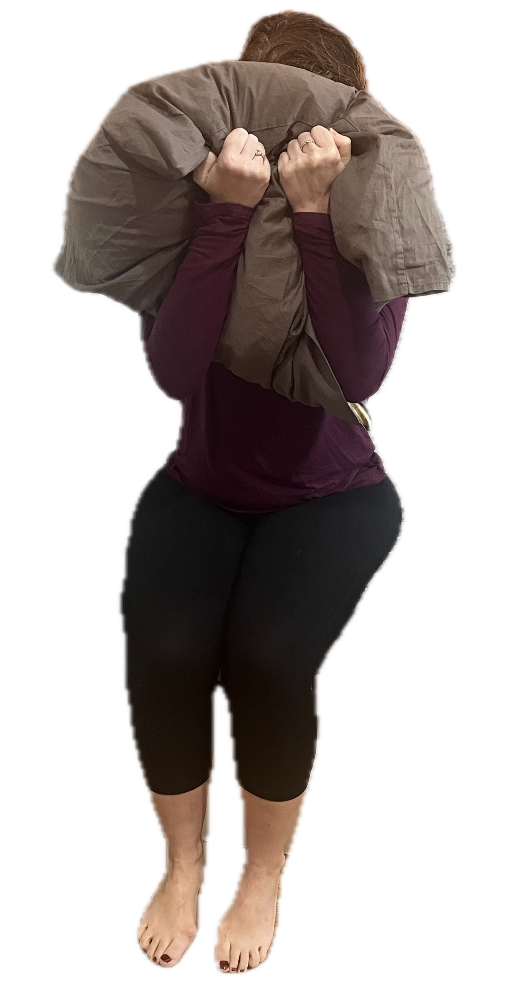
Alternative Positions
Pillow Screaming

Slide 14
Alternative Positions
Pillow Screaming

Slide 15
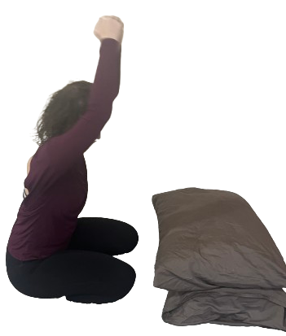
Pillow Pounding
Technique #4
Exhale
“NO!”
Hitting the pillow

Slide 16
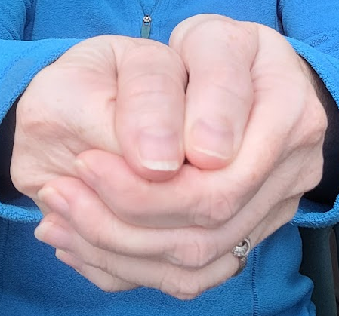
Hand Position
1. Make a fist.
3. Wrap second hand around
the closed fist.
2. Thumb on the outside.
4. Second thumb sits beside the first

Slide 17
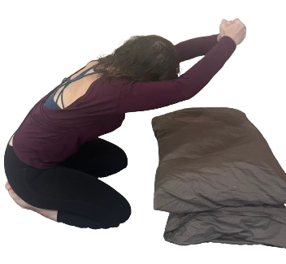
Strike

Slide 18
Hinge

Slide 19
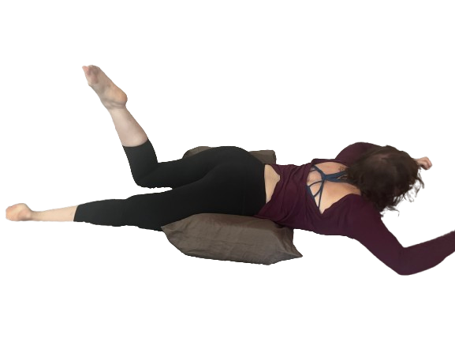
Tantrum
Technique #5
“Ahhh!!”
“I said no!”
Slapping the bed
Stomping feet
Exhale

Slide 20
Face Down
Tantrum Position #2

Slide 21
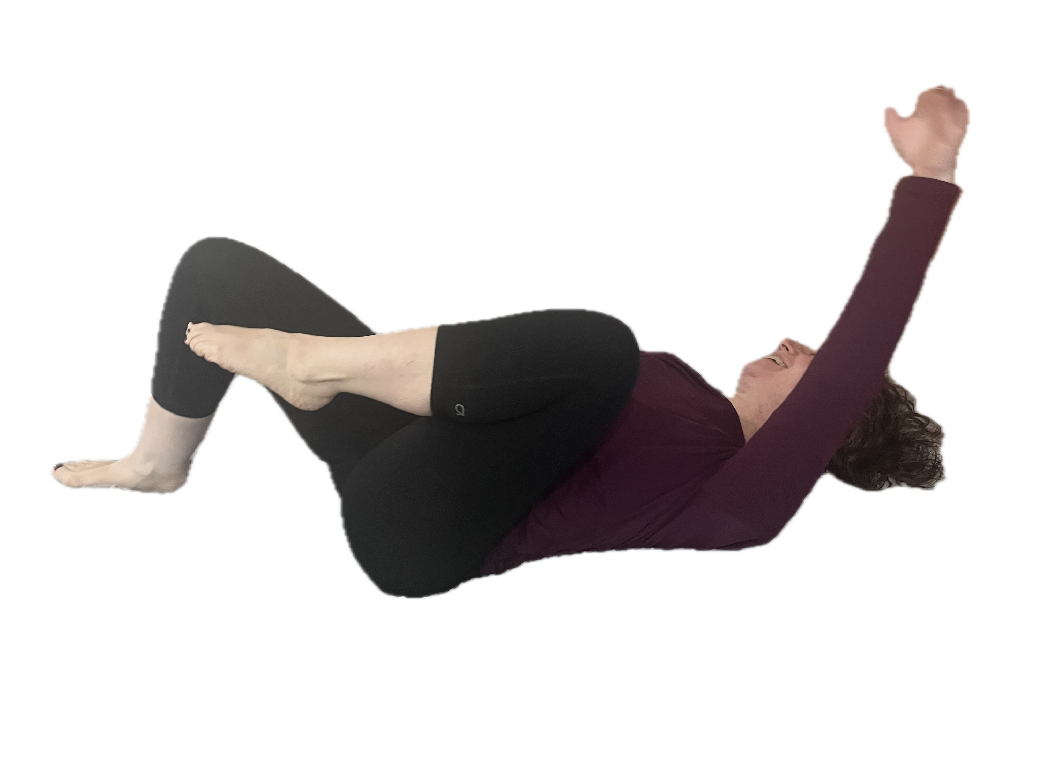
Alternative Position
Tantrum

Slide 22
Tantrum
Technique #5
“Ahhh!!”
“I said no!”
Slapping the bed
Stomping feet
Exhale

Slide 23
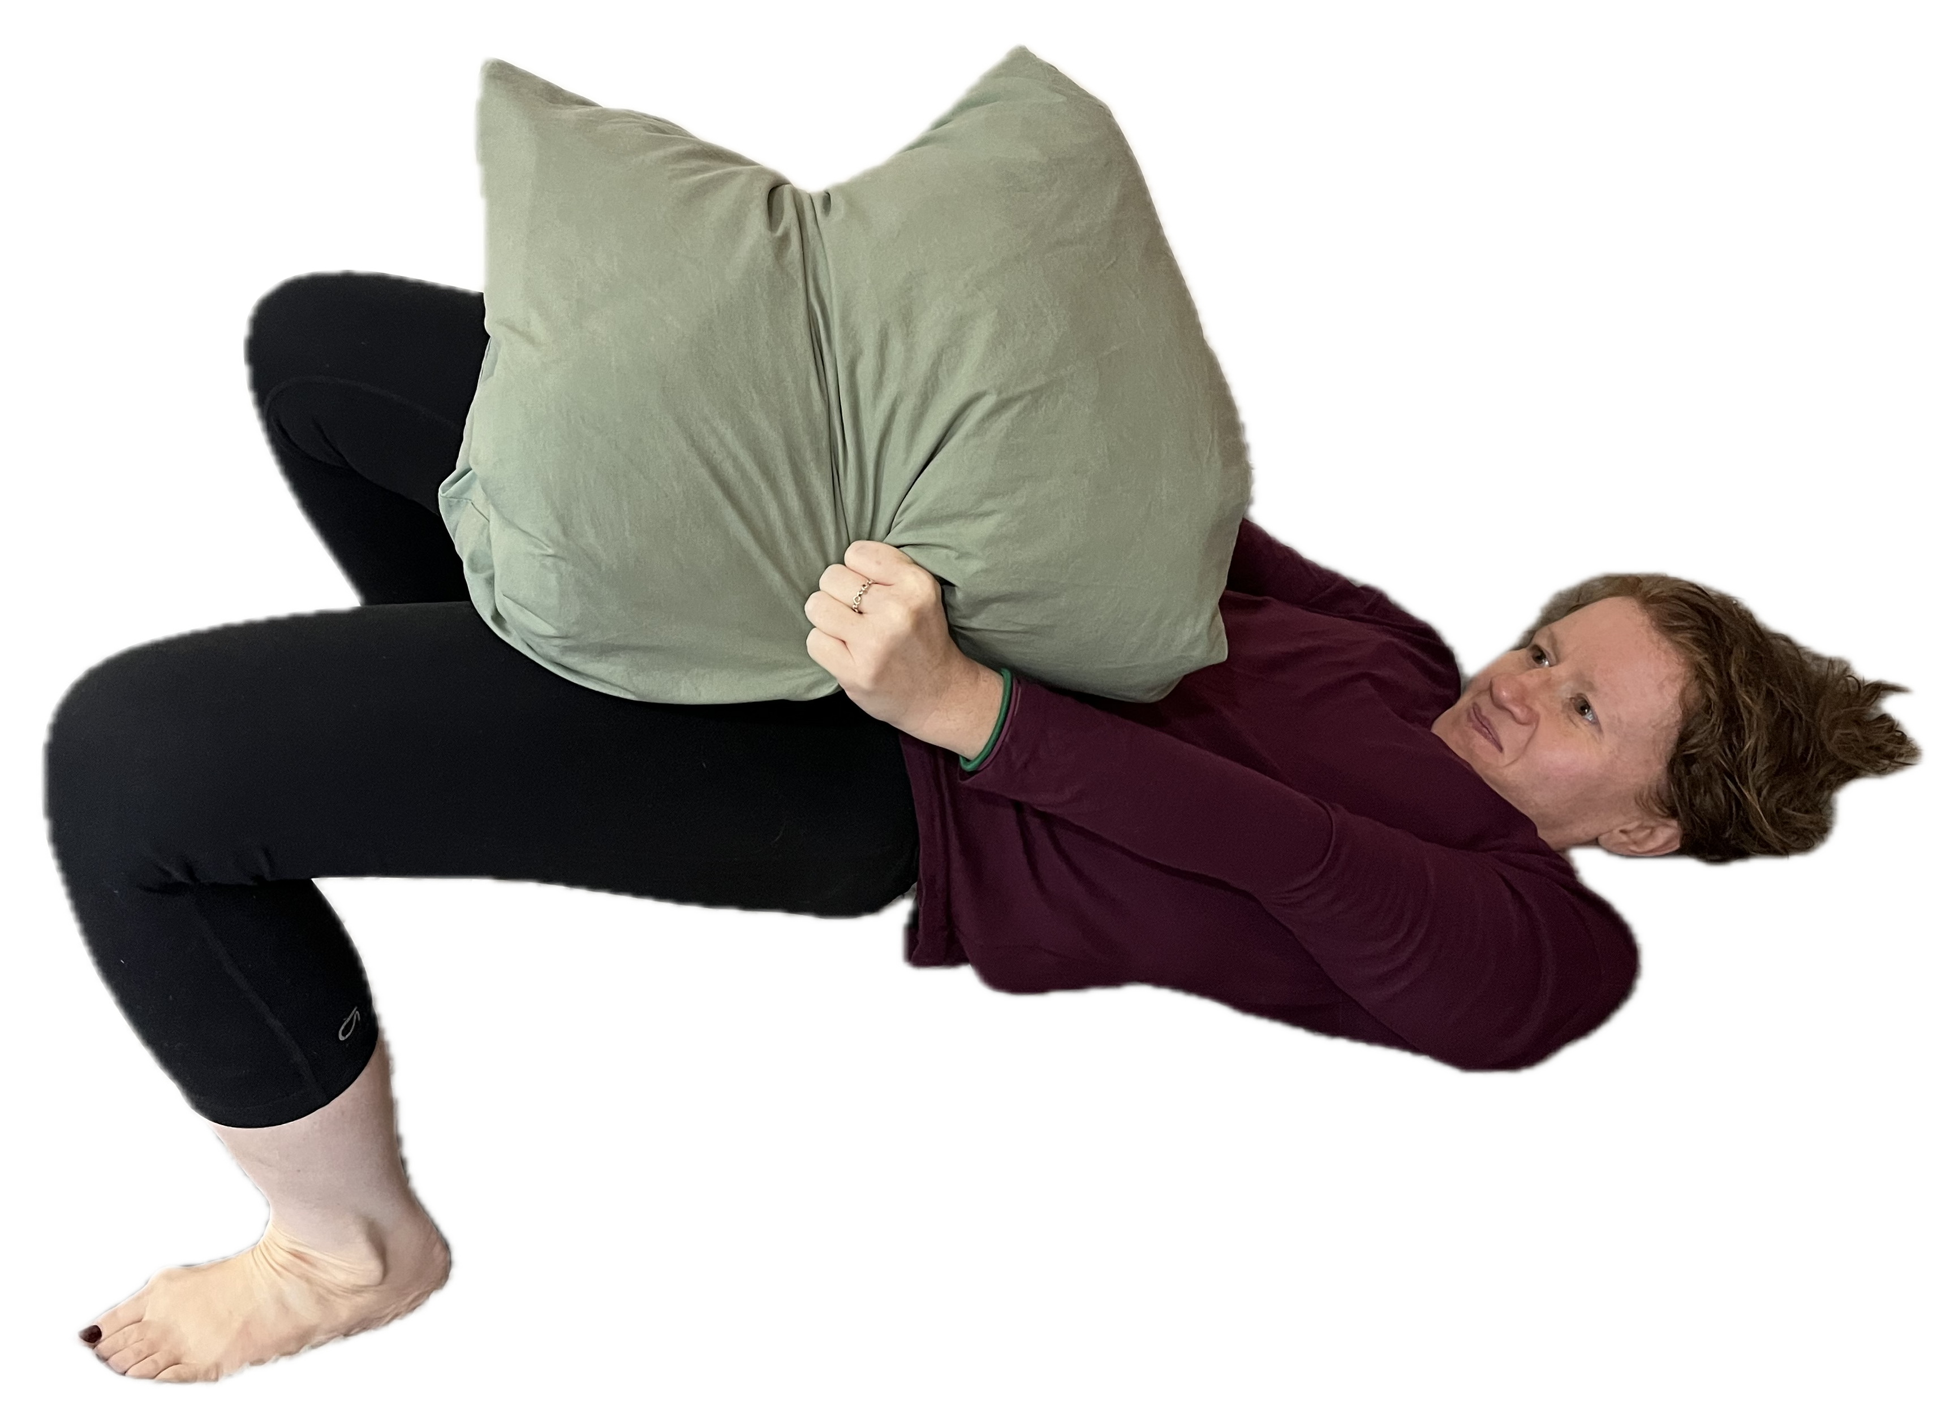
Core Release
Technique #6
Pillow between
knees; Focus
on hip thrusting
“NO!”
“Uh”
Exhale

Slide 24
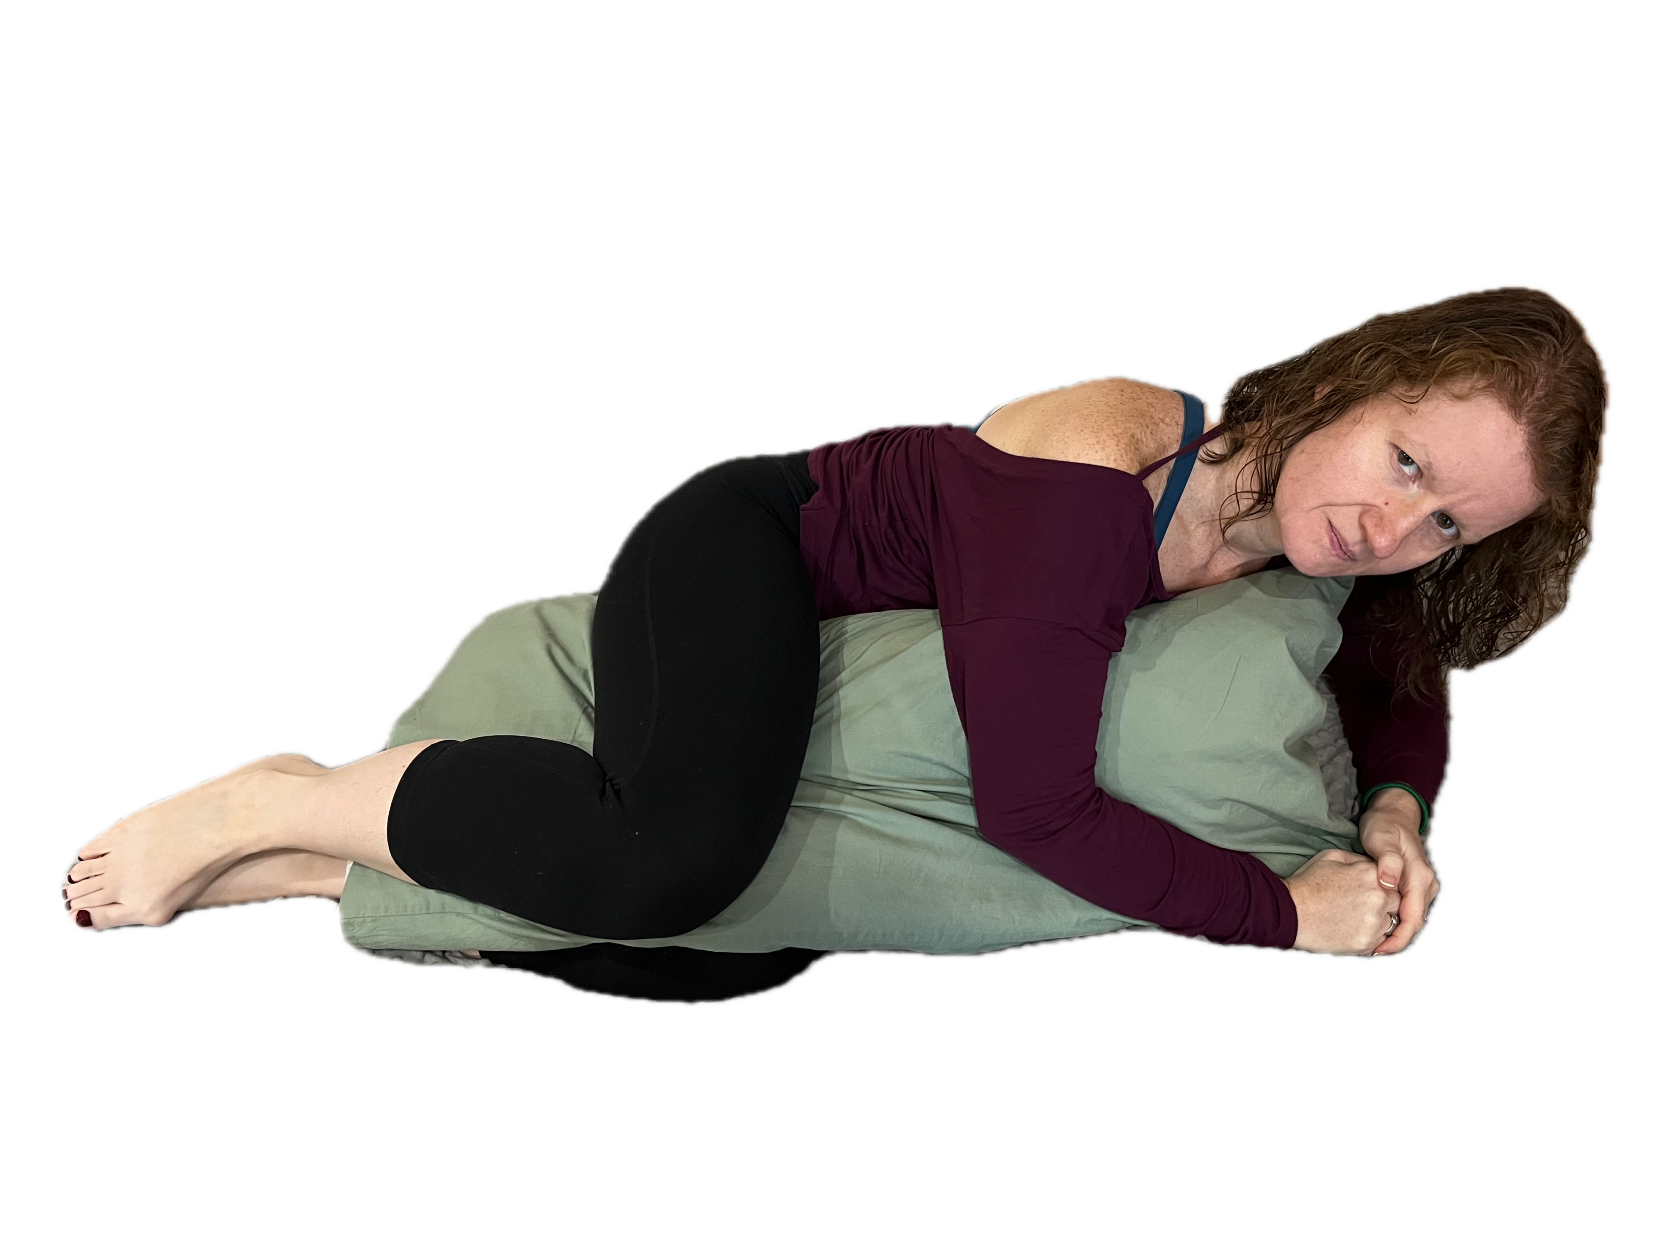
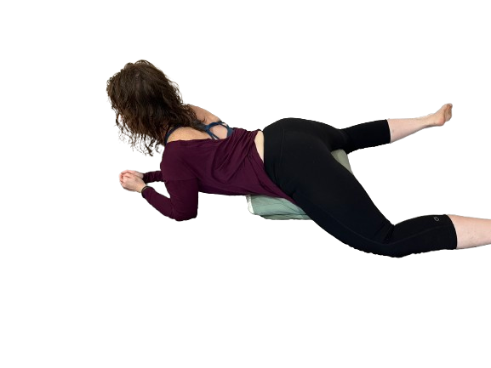
Alternative Positions
Core Release

Slide 25
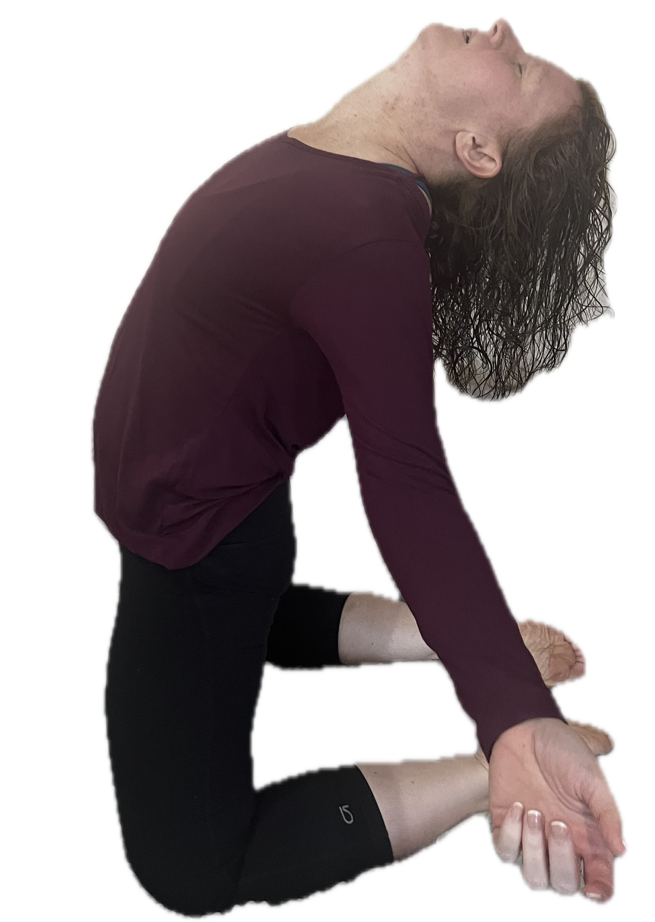
Grief Ritual or Wailing
Technique #7
Cry
Wail
Arms open to
the side,
shoulders back
body shaking
Exhale

Slide 26
On knees
Grief Ritual #1

Slide 27
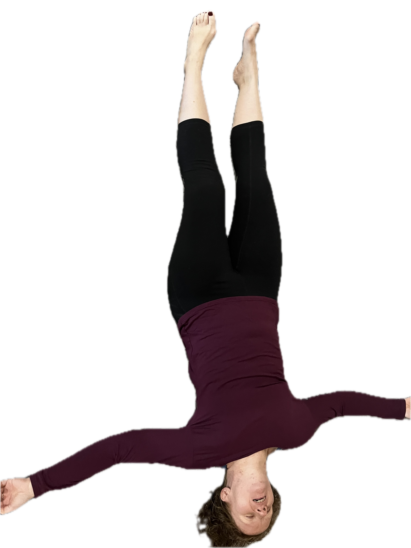
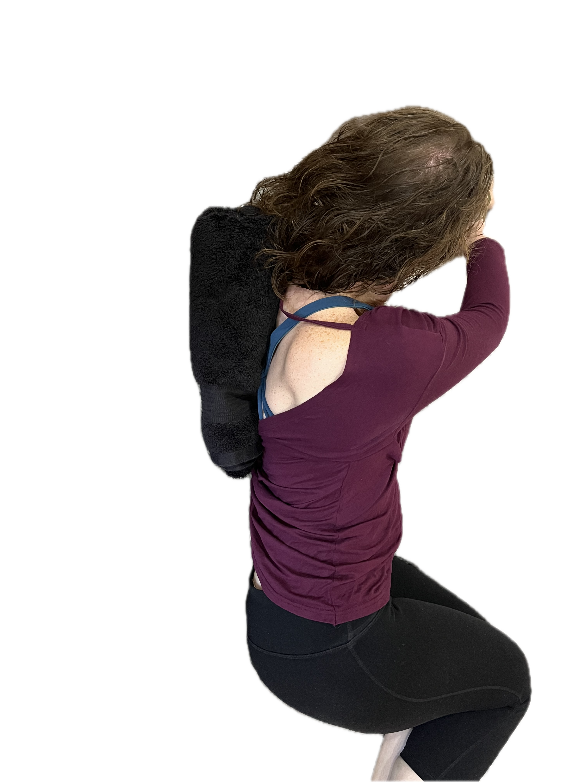
Alternative Position
Towel Roll
Grief Ritual or Wail

Slide 28
Wailing
Pillow Pounding
Core Release
Tantrum
Pillow Screaming
Foot Stomping
Hand Screaming
Emotional
Release

Slide 29

Thank You
github.com/DancinFosse/Talks/blob/main/emotional_release.md
Notes:
https://github.com/DancinFosse/Talks/blob/main/emotional_release.md

